Slide 1
Presentation brief for MCT’s
Title of presentation | Enhance a Bot with LUIS
Presentation length | 30 minutes.
Audience | Azure AI Engineers, Azure Developers.
Purpose | Understand how language understanding plays a part in AI applications Understand how to get connection information for LUIS Understand how to integrate LUIS and Bots
(think) Student key takeaways | The student should understand how LUIS provides language understanding to AI applications The student should understand how to find the connection information for the Bot and LUIS The student should know how to integrate LUIS and Bots
(feel) Student desired mindset | The student should understand how to use LUIS to provide natural language understanding for a Bot
(do) Student outcomes | The student should be able to locate endpoint and key values for the services The student should be able to integrate LUIS and a Bot
More information | For course feedback, please use the MCT forums

Slide 2

AI-100T01A Module 05: Enhance your Bot with LUIS

Slide 3
Agenda
Introducing Language Understanding in AI
Integrate LUIS and a Bot
Lab: Integrate LUIS with the Bot

Slide 4


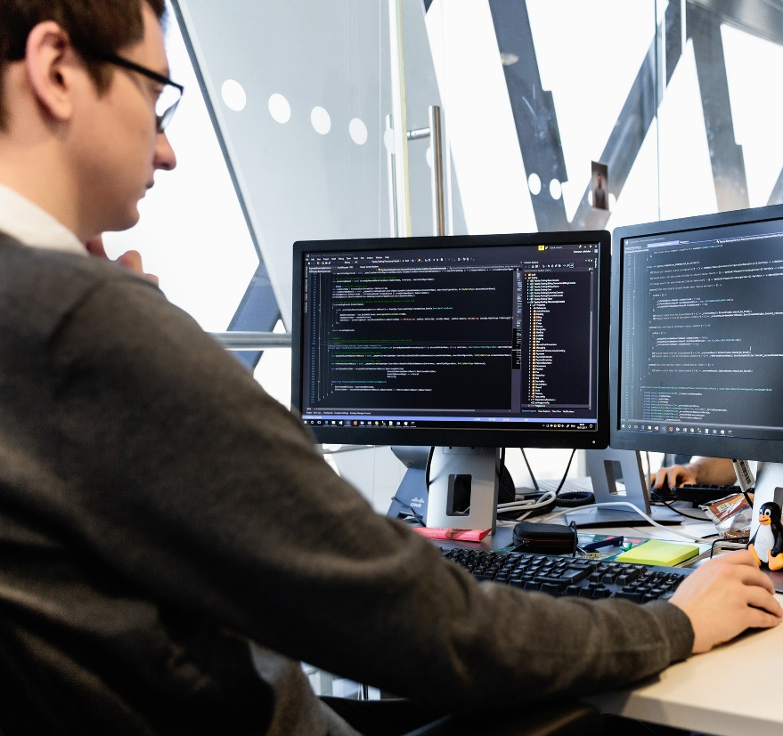
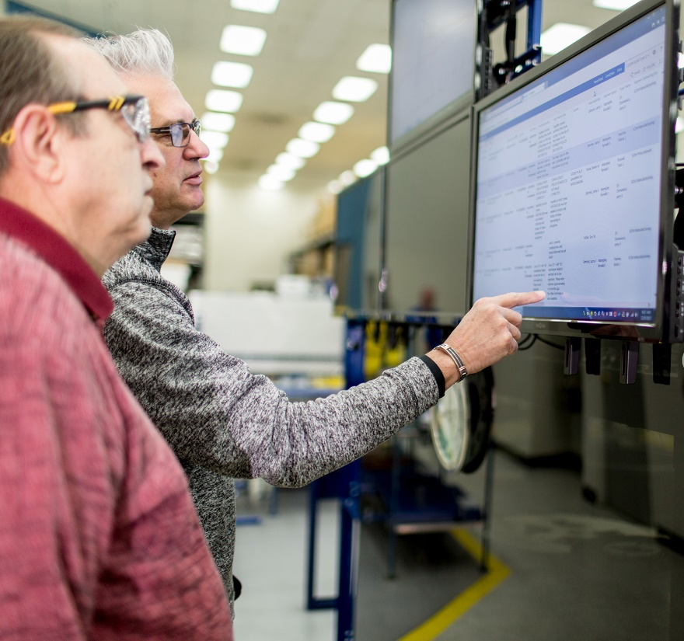



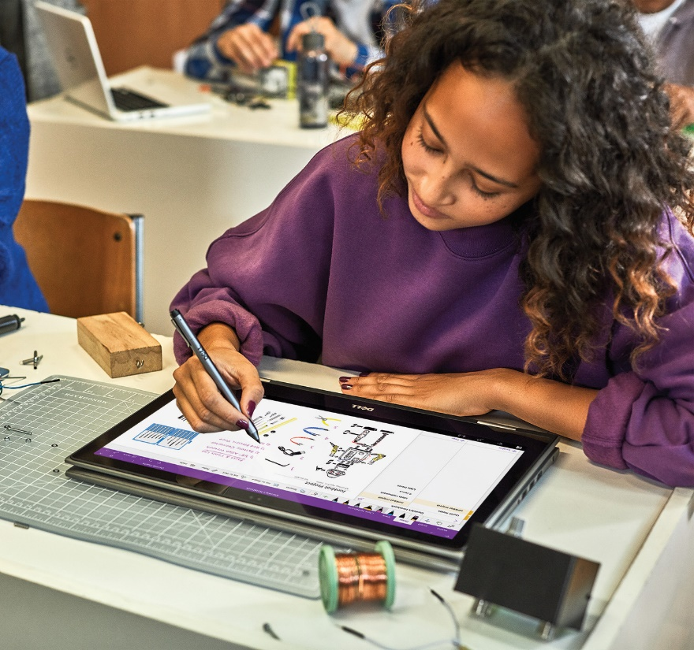


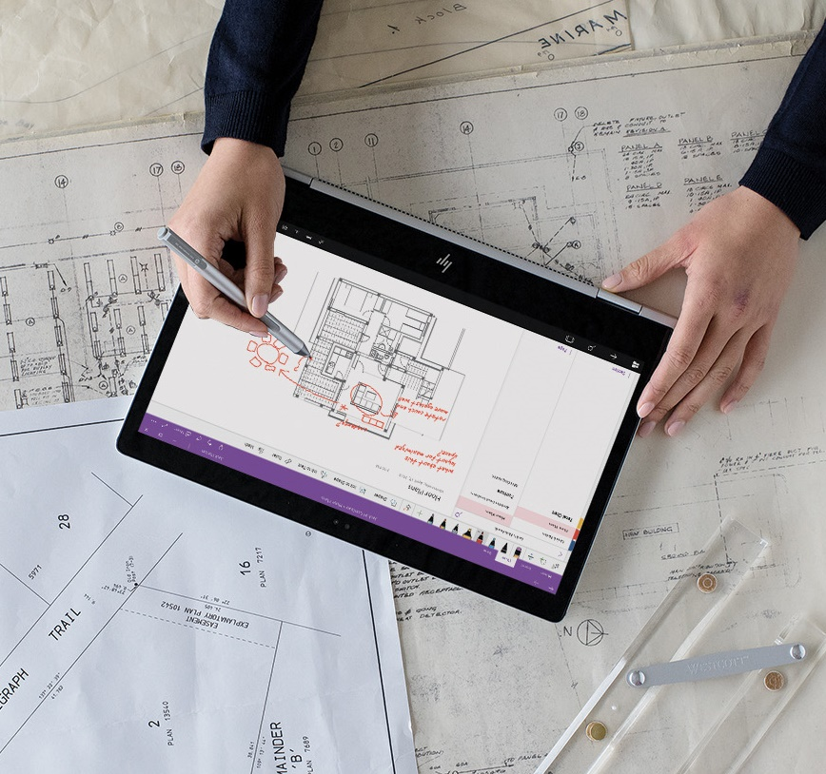
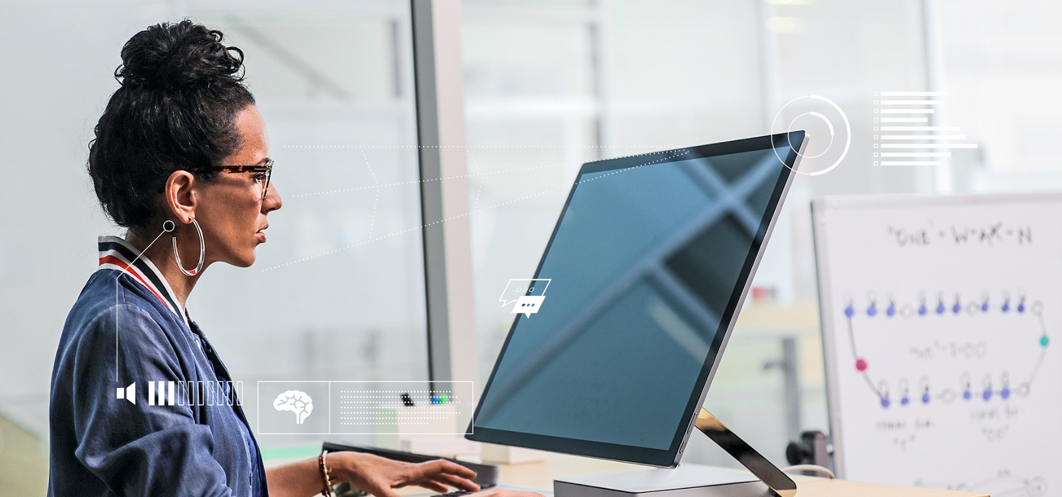
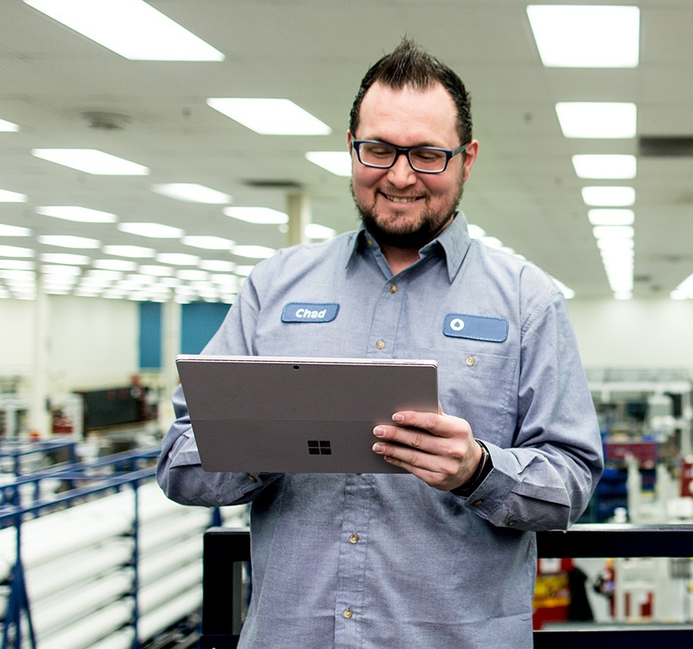
Lesson 01
Overview of Language Understanding in AI Applications
Data
Cloud
AI

Slide 5
Lesson Objectives
L01 – Introduce Language Understanding in AI Applications
L02 – Understand the Connection Points for LUIS and Bots

Slide 6
Introduction
Connecting your bot to a LUIS application can provide the bot with the ability to understand language.

Slide 7
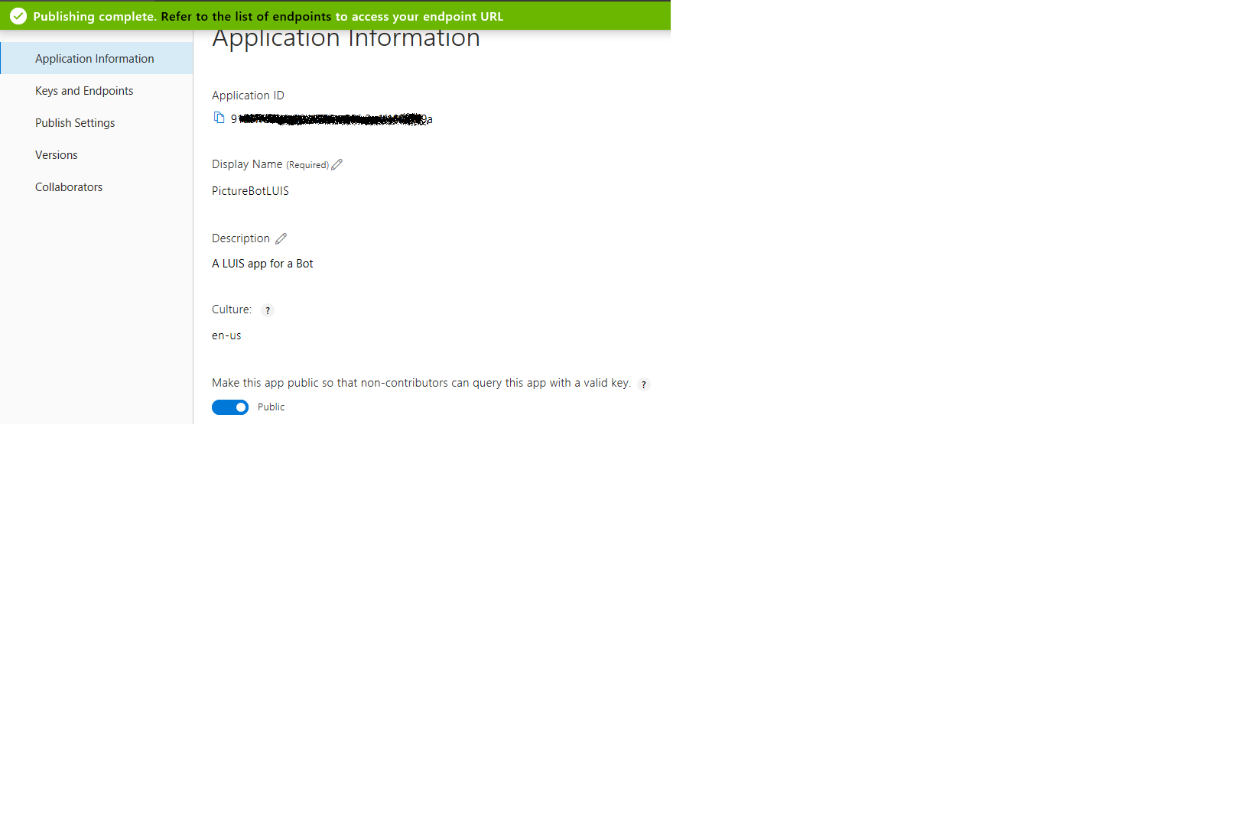
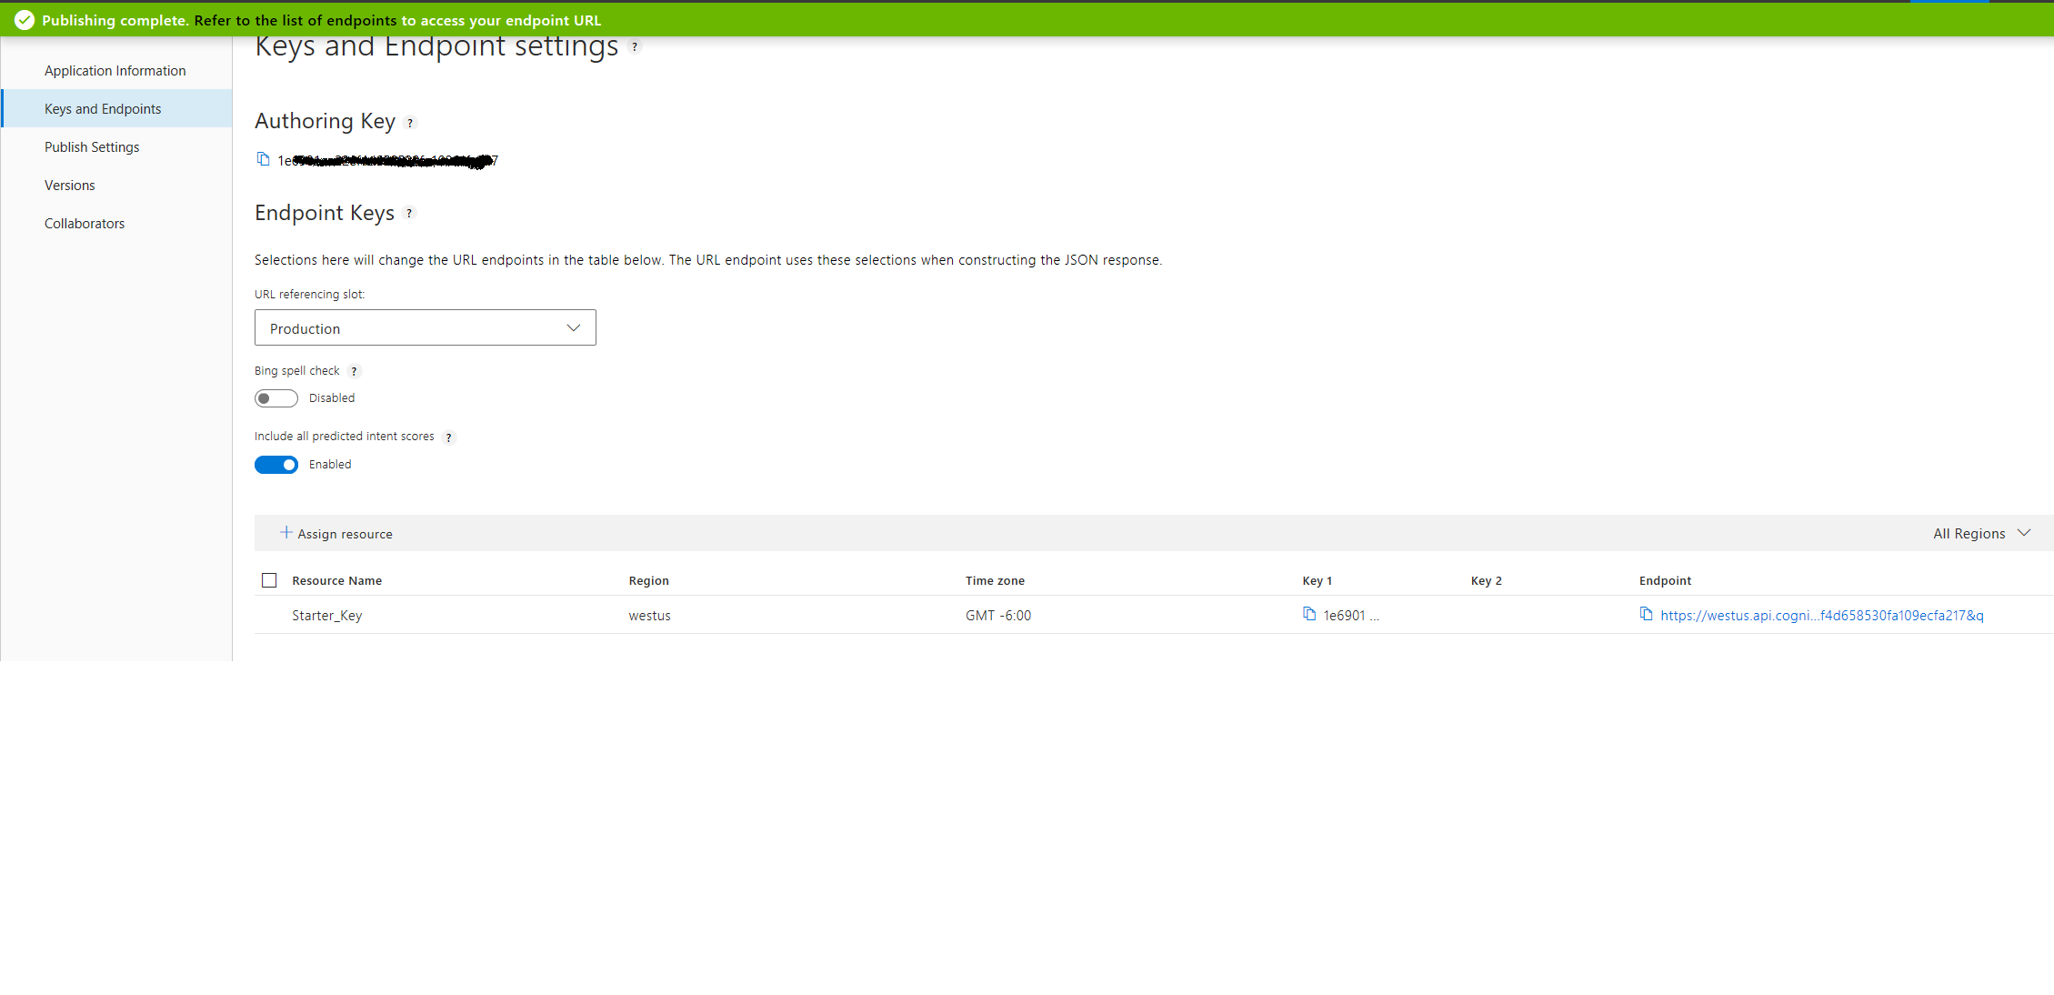
Accessing your LUIS App

Slide 8
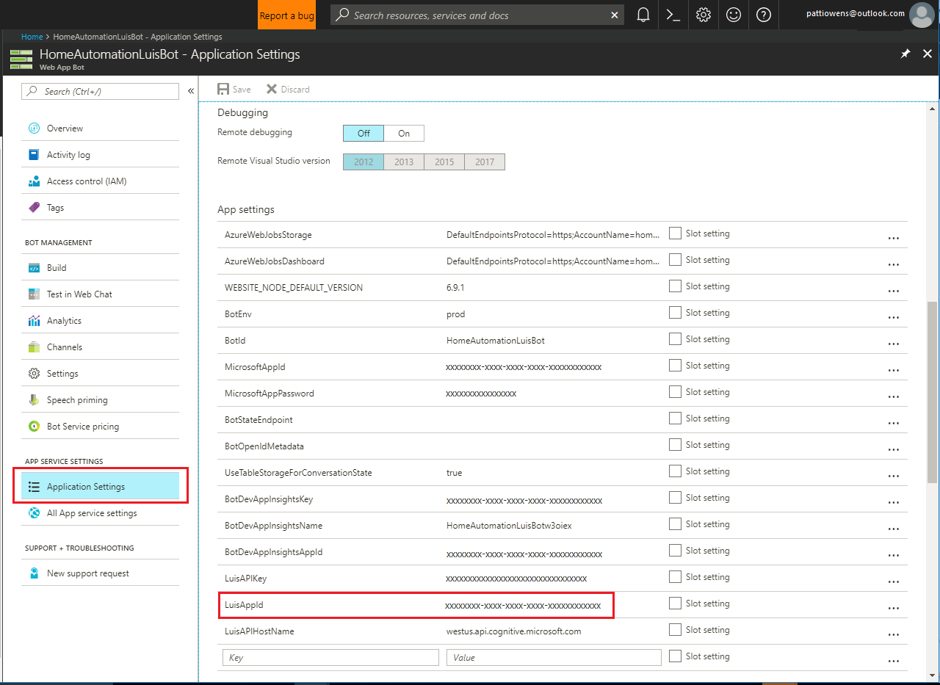
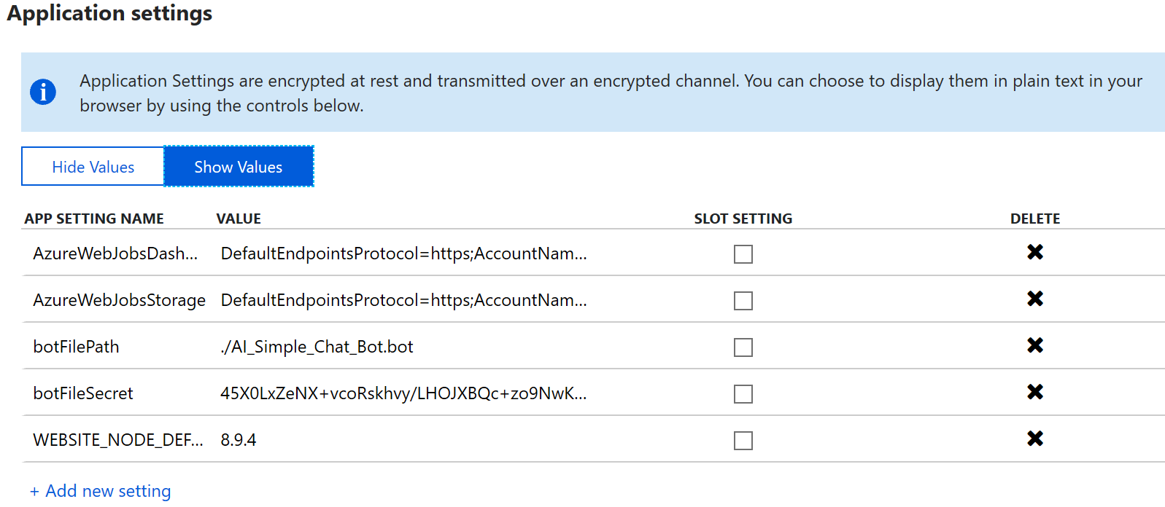
Integrating LUIS and a Bot
Visual Studio application uses appsettings.json file.
{
"botFileSecret": "",
"botFilePath": ""
}
Integrate LUIS with web bot

Slide 9
Lesson 02
Integrating LUIS with a Bot
Data
Cloud
AI

Slide 10
Lesson Objectives
L01 – Guided Walkthrough, Integrate LUIS and a Bot

Slide 11
Walkthrough – Integrate LUIS and a Bot

Slide 12
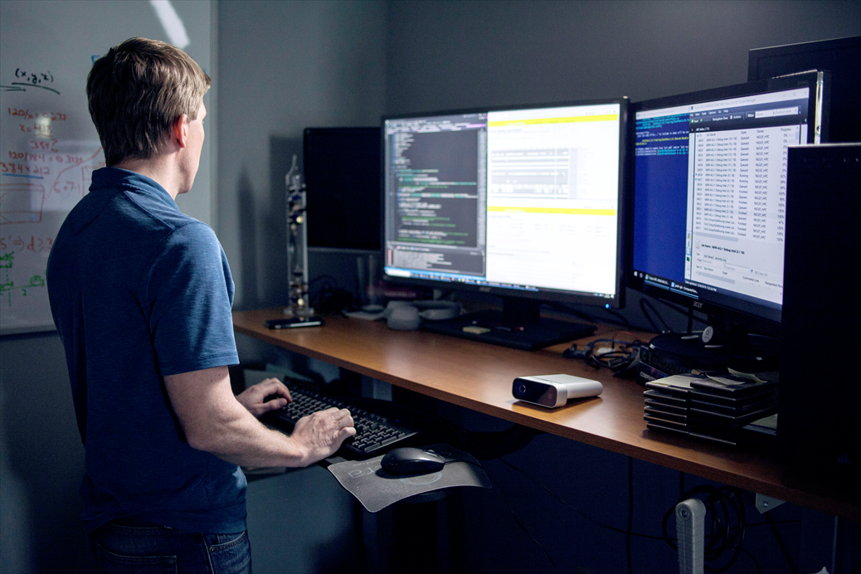
Lab 7: Integrate LUIS into Bot Dialogs

Slide 13
Lab Objectives
Add LUIS to your C# Code
Add LUIS to the PictureBot Dialog
Test the LUIS Service

Slide 14
Lab Scenario
Our bot is now capable of taking in a user's input and responding based on the user's input. Unfortunately, our bot's communication skills are brittle. One typo, or a rephrasing of words, and the bot will not understand. This can cause frustration for the user. We can greatly increase the bot's conversational abilities by enabling it to understand natural language with the LUIS model we built

Slide 15
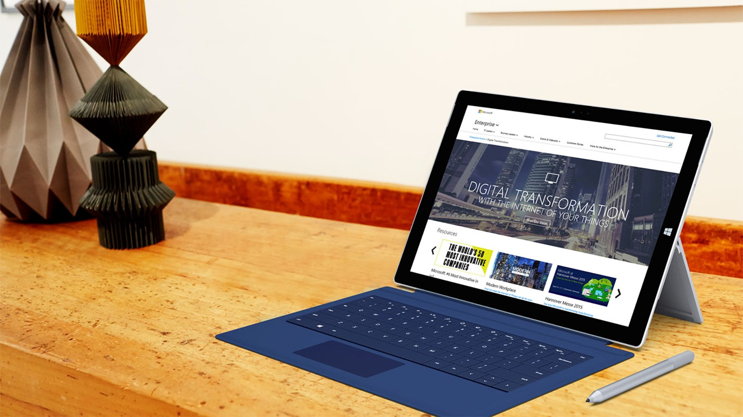
Next steps
Module Summary
In this module, you have learned about:
Language Understanding in an AI Setting
Connection Properties for LUIS and Bots
How to Integrate LUIS and Bots
After the course, consider exploring the scenarios and case studies on the LUIS documentation pages on Microsoft’s Azure Web Site.

